Slide 1
GDP2-Sec1-04 ConnectCompany
Developers
Vivek Drakshapally
Saikiran Reddy Gangidi
Nikhil Reddy Pannala
Venkat Sai Jarugula

Slide 2
Why this app? Who will use it, what is the main purpose?
Our application Connect Company allows users to get notified and subscribe to different events happening in a company such as the job events, new product lauch events and many more.
This app will be very helpful to the students and job aspirants who want to know and participate in the events conducted by the company of their interest.

Slide 3
Tech stack
Backend AdonisJs
Host Heroku
Frontend Vue JS
Front-end responsive design Bootstrap,vue-Bootstrap
DB Host Clever Cloud

Slide 4
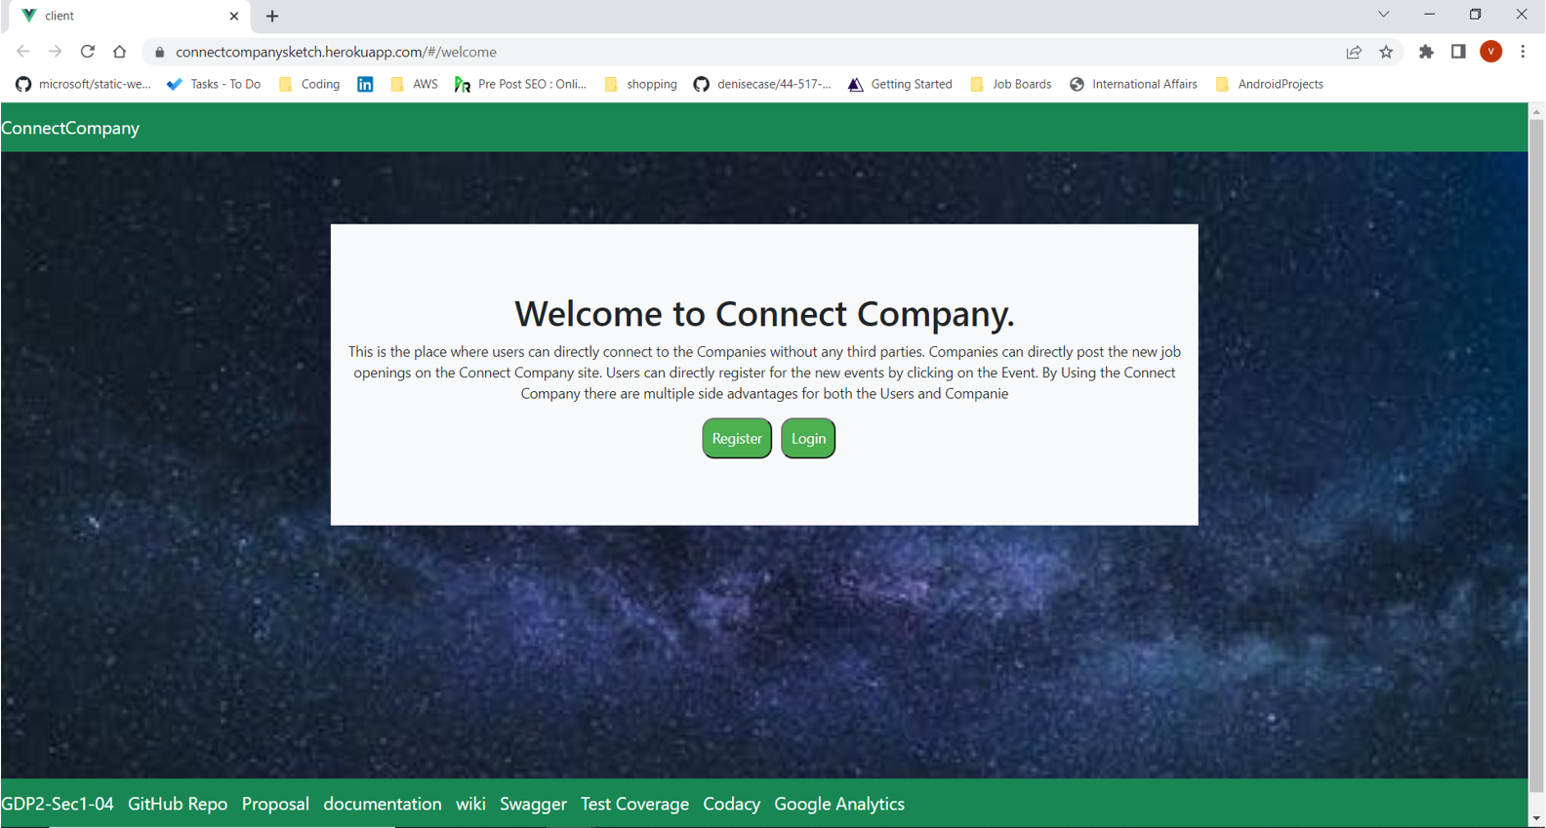
Home Page

Slide 5
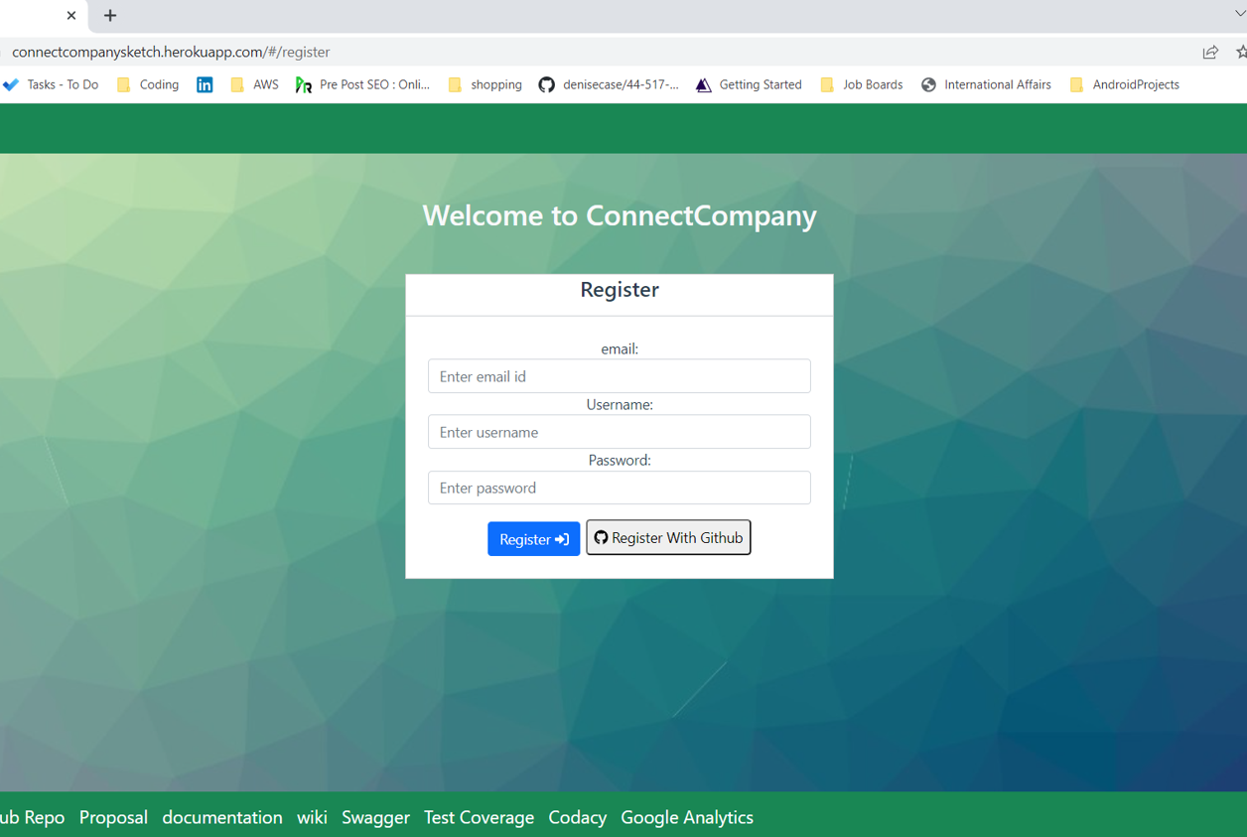
Register Page
This page helps the new user to register into the application by providing details such as email, username and password

Slide 6
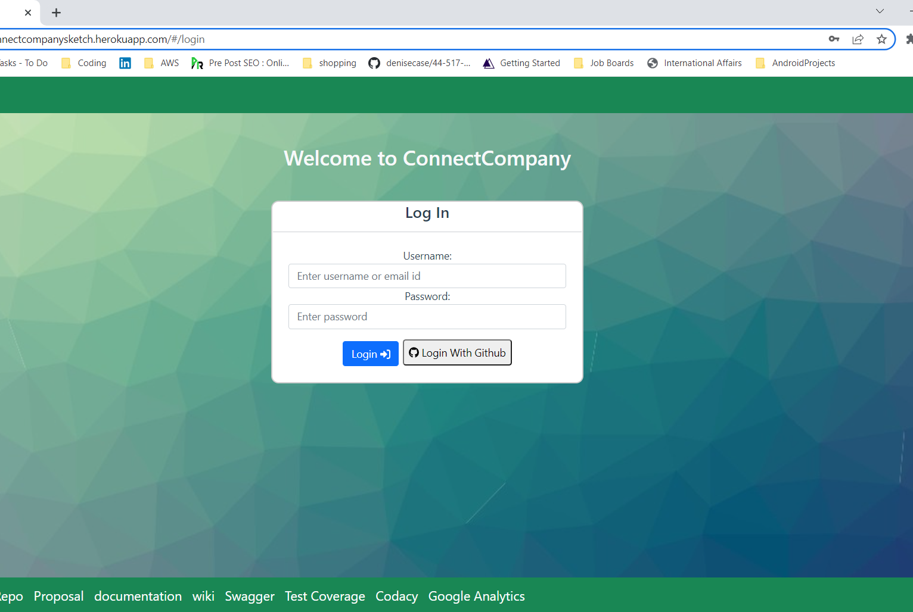
Login Page
This page helps the registered user to login by providing the user credentials.
User will be navigated to their respective dashboard according to their role.
The role can be a user, company user and admin.

Slide 7
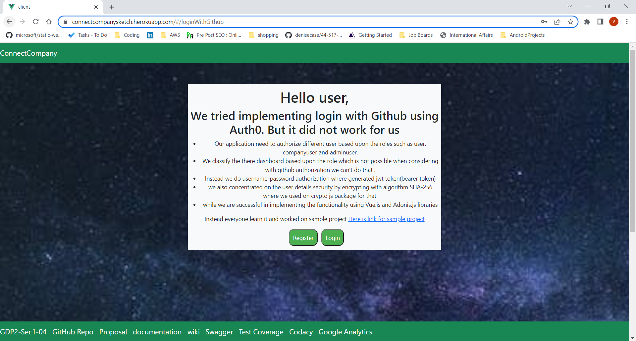
Tried implementing Auth0.But no luck.

Slide 8
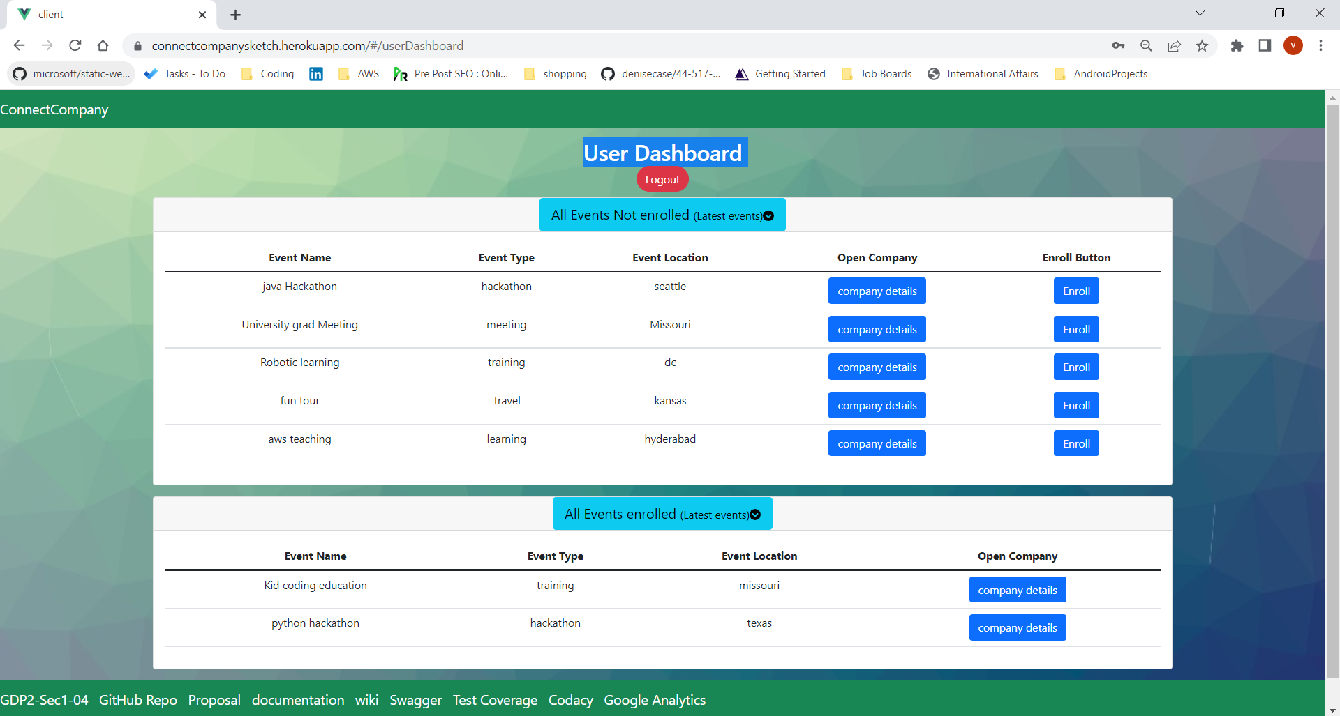
User Dashboard

Slide 9
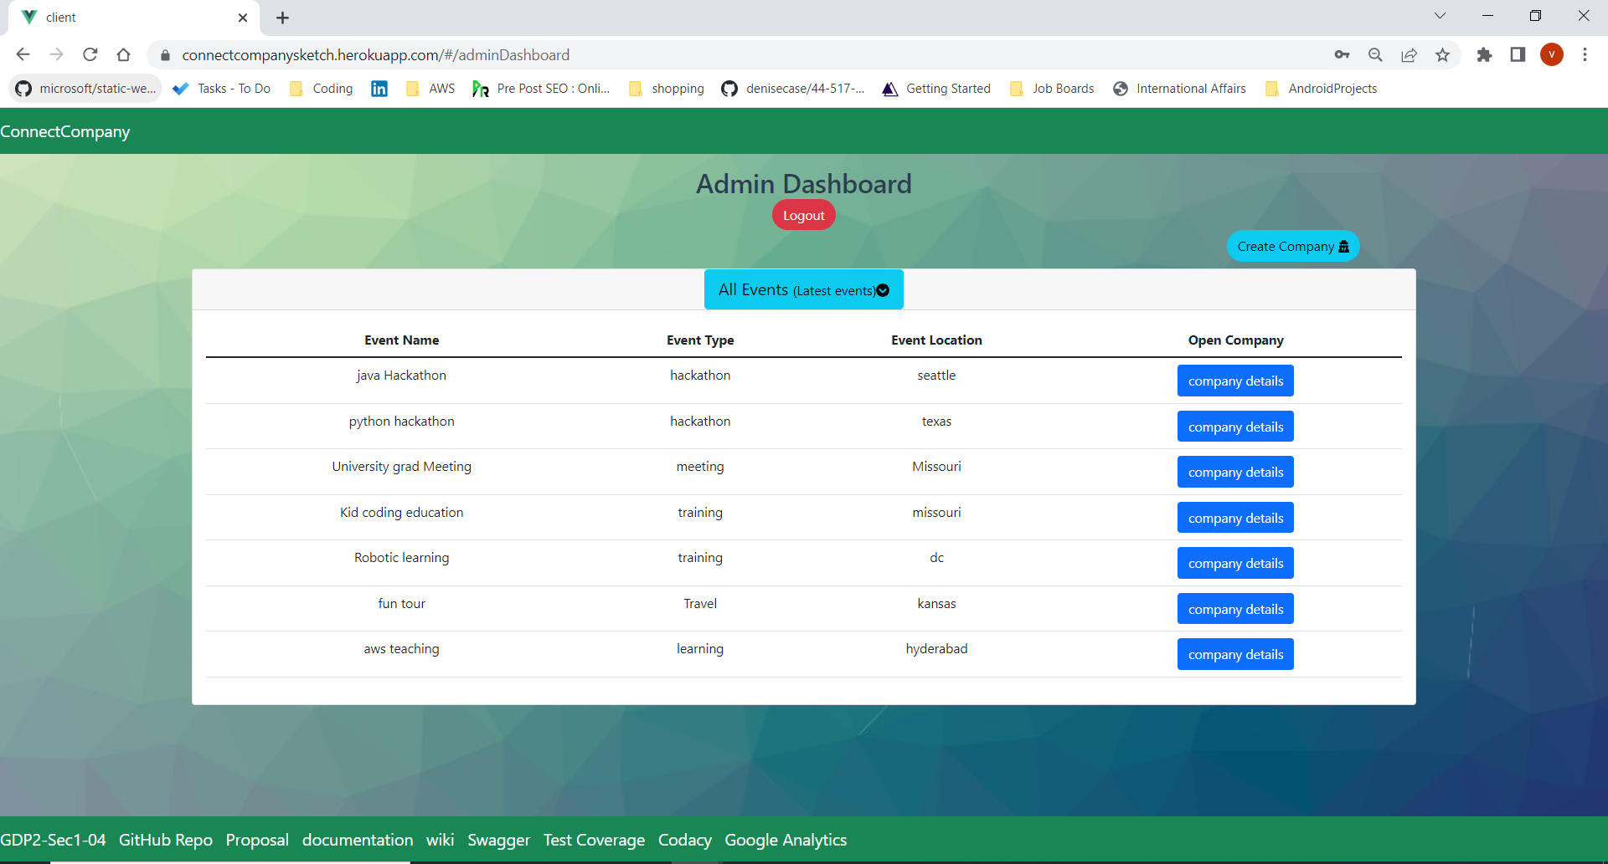
Admin Dashboard

Slide 10
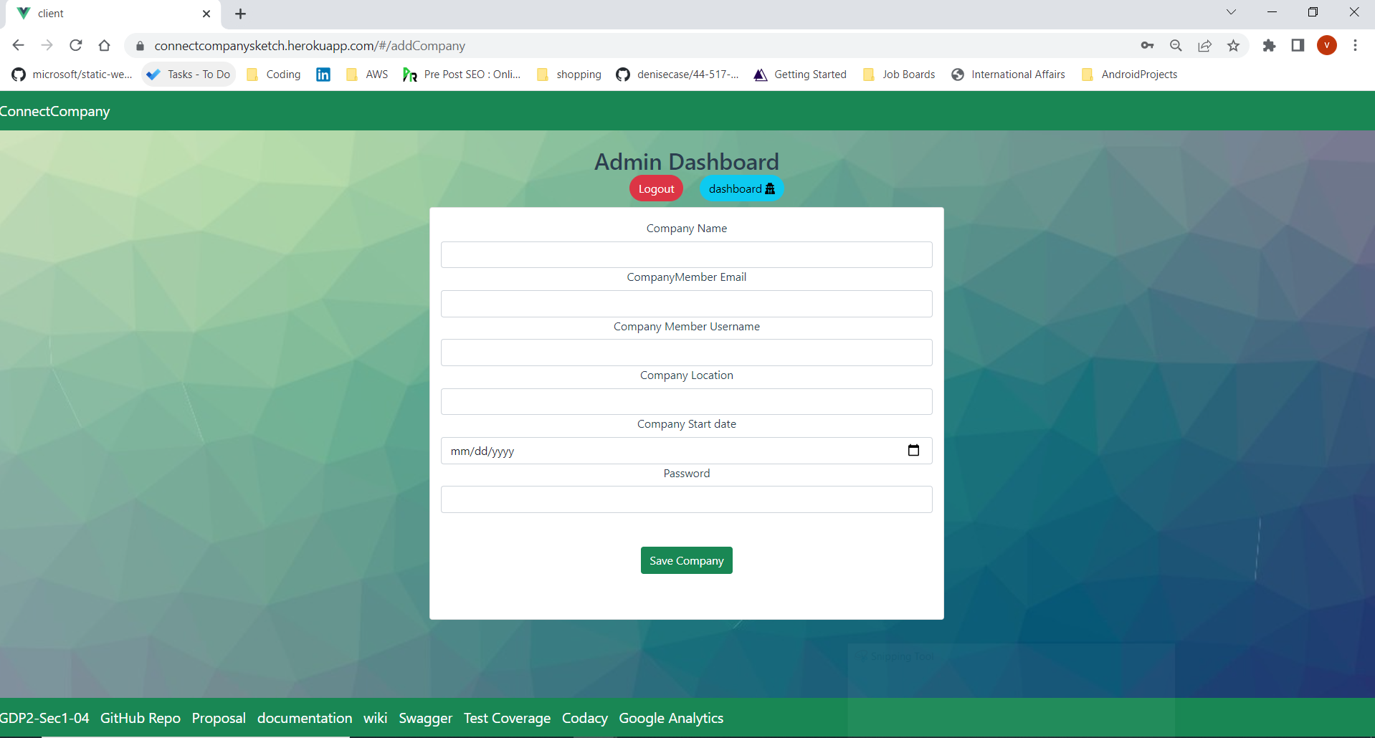
Admin Dashboard- Add new company

Slide 11
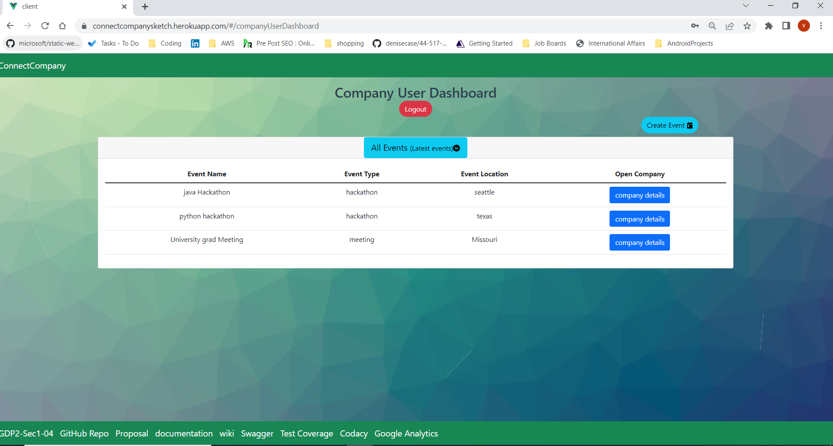
Company User Dashboard

Slide 12
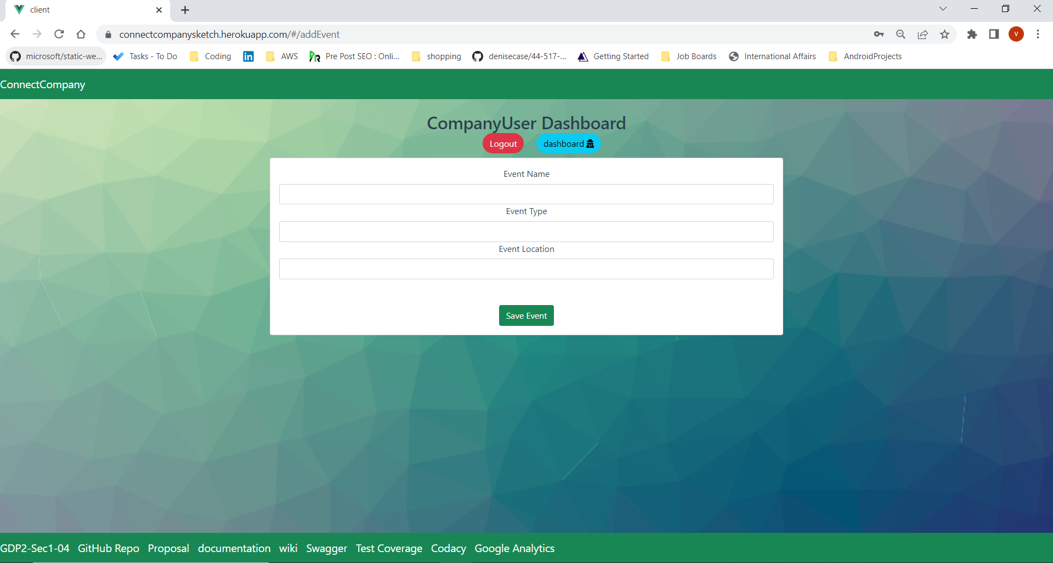
Company User Dashboard – Add new Event

Slide 13
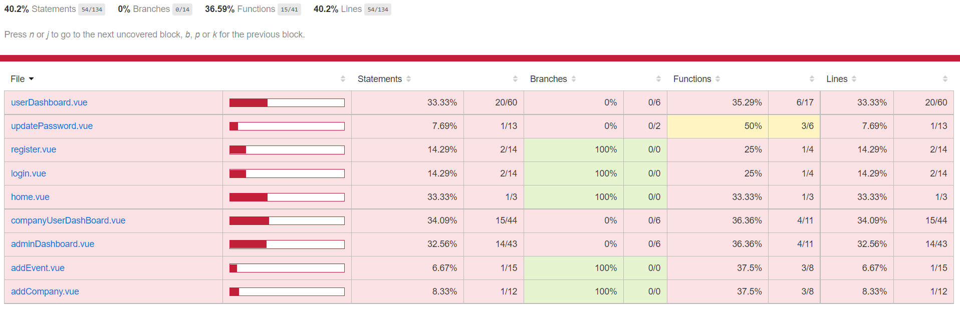
Test Coverage
https://saikiranreddygangidi.github.io/jest-testcoverage-connectcompany/

Slide 14
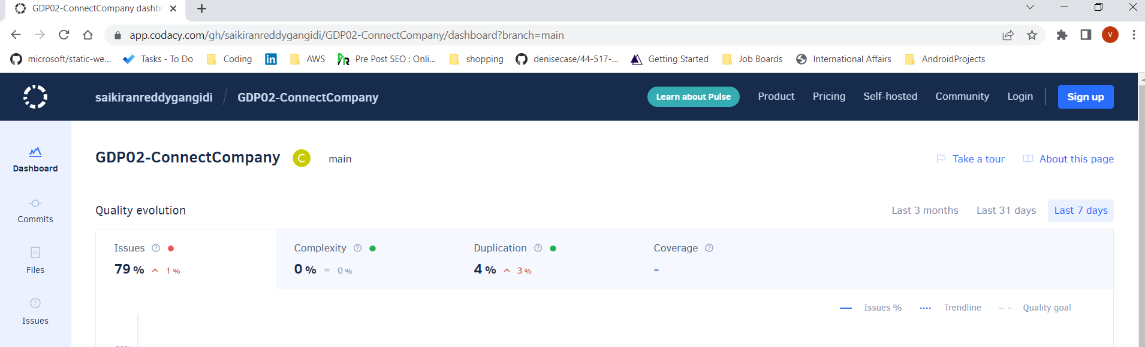
Codacy
https://app.codacy.com/gh/saikiranreddygangidi/GDP02-ConnectCompany/dashboard

Slide 15
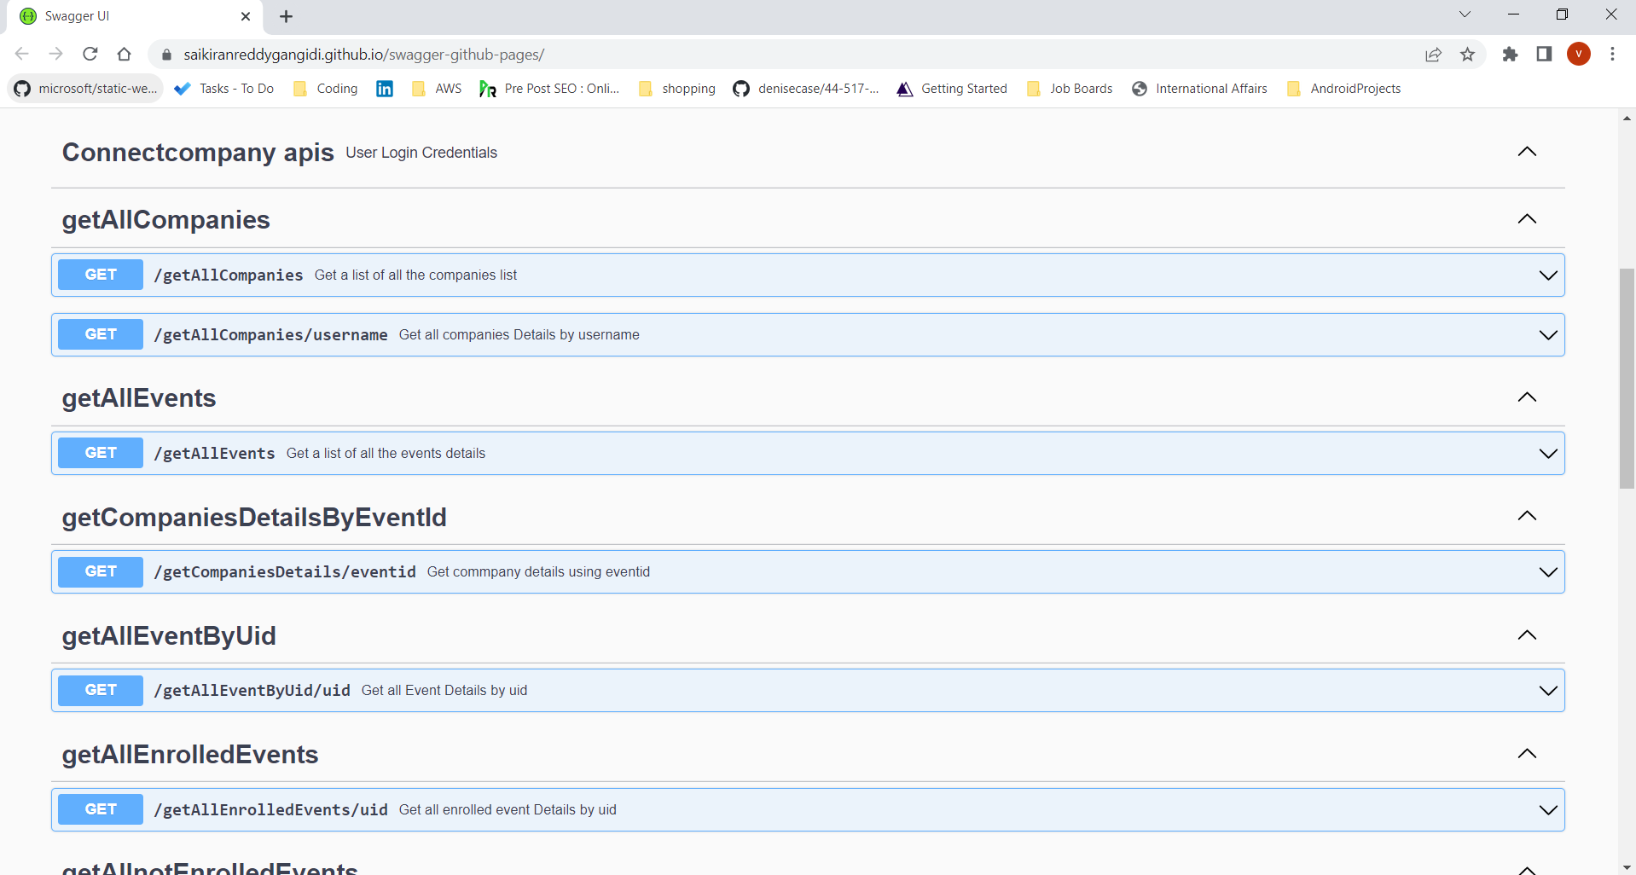
Swagger
https://saikiranreddygangidi.github.io/swagger-github-pages/

Slide 16
Lessons learned
We learned the importance of code analysis as it helps in minimizing the security issues and basic code style issues.
We learned about SWAGGER to generate interactive API documentation in client-side and server-side.
This was the first time we have tested our app using JEST. We have gained experience in unit testing and behavioral testing.
This was the first time we have implemented GitHub Actions. Apart from these we have learnt about GitHub issues, update work log in wiki, deal with merge conflicts, and create a pull request.

Slide 17
Status - links, release, complete, any additional work planned?
Github repo link :https://github.com/saikiranreddygangidi/GDP02-ConnectCompany
Heroku link: https://connectcompanysketch.herokuapp.com/
Swagger link: https://saikiranreddygangidi.github.io/swagger-github-pages/
Codacy link: https://app.codacy.com/gh/saikiranreddygangidi/GDP02-ConnectCompany/dashboard
Code Coverage link: https://saikiranreddygangidi.github.io/jest-testcoverage-connectcompany/

Slide 18

Thank You

